Slide 1




Loops, Arrays, Strings and Objects
Loops, Arrays, Strings and Objects
JavaScript
Basics
SoftUni Team
Technical Trainers
Software University
http://softuni.bg

Slide 2


Table of Contents
Loops in JavaScript
while, do-while, for, for-in
Arrays in JavaScript
Declaring and Creating Arrays
Accessing and Processing Array Elements
Strings in JavaScript
Processing, Escaping, Trimming, Padding

Slide 3

Loops

Slide 4
Types of Loops in JS
Types of loops in JS
while(…) loop
do { … } while (…) loop
for loop
for-in loop
Infinite loops – a loop that never ends
Nested loops – a composition of loops

Slide 5
How To Use While Loop?
The simplest and most frequently used loop
The repeat condition (loop condition)
The condition is evaluated to true or false
5, "non-empty", etc. are evaluated as true
0, "", null are evaluated as false
while (condition) {
statements;
}

Slide 6
Using Do-While Loop
Another classical loop structure is:
The block of statements is repeated
While the boolean loop condition holds
The loop is executed at least once
do {
statements;
} while (condition);

Slide 7
For Loop – Definition
Initialization
Test
Update
for (var number = 0; number < 10; number++) { // Can use number here } // number is still usable here
Body
Initialization – executed once, just before the loop is entered
Test – checked before each iteration of the loop (loop condition)
Update – executed at each iteration after the loop body
Body – the code that will be executed at each iteration

Slide 8
Using break Operator
The break operator exits the inner-most loop
var n = 5;
var fact = 1;
var factStr = 'n! = ';
while (true) {
if (n == 1)
break;
factStr += n + '*'
fact *= n;
n--;
}
factStr += '1 = ' + fact;
console.log(factStr);

Slide 9

for-in Loop
Iterating over the Properties of an Object

Slide 10
What is for-in Loop?
for-in loop iterates over the properties of an object
For arrays / strings iterates over their indices (0…length-1)
For any other object, for-in iterates over its properties
Iterating over the elements of an array / string:
var arr = [10, 20, 30, 40, 50];
for (var index in arr) { console.log(arr[index]) }
// 10, 20, 30, 40, 50
var str = "welcome";
for (var index in str) { console.log(str[index]) }
// w, e, l, c, o, m, e

Slide 11
For-in Loop
Iterating over the properties of an object:
Typical mistake is to use the key instead of the value:
var obj = { name: 'Steve', age: 23, location: 'Sofia' };
for (var key in obj) { console.log(obj[key]); }
// Steve, 23 , Sofia
var obj = { name: 'Steve', age: 23, location: 'Sofia' };
for (var key in obj) { console.log(key); }
// name, age, location
var arr = [10, 20, 30, 40, 50];
for (var i in arr) { console.log(i); }
// 0, 1, 2, 3, 4

Slide 12
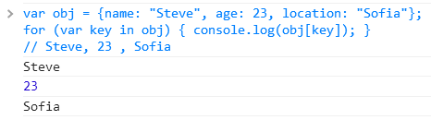
for-in Loop
Live Demo

Slide 13

Arrays

Slide 14
What are Arrays?
An array is an ordered sequence of elements
The order of the elements is fixed
Can get the current length (Array.length)
In JS arrays can change their size at runtime (add / delete)
Element of an array
0 1 2 3 4
Element index
Array of 5 elements
… | … | … | … | …

Slide 15

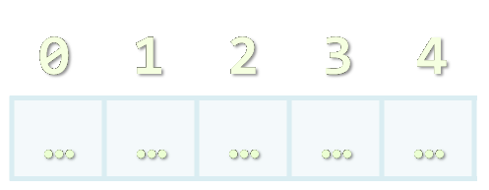

Creating Arrays

Slide 16
Creating Arrays in JavaScript
// Array holding integers
var numbers = [1, 2, 3, 4, 5];
// Array holding strings
var weekDays = ['Monday', 'Tuesday', 'Wednesday',
'Thursday', 'Friday', 'Saturday', 'Sunday'];
// Array of mixed data
var mixedArr = [1, new Date(), 'hello'];
// Array of arrays (matrix)
var matrix = [
['0,0', '0,1', '0,2'],
['1,0', '1,1', '1,2'],
['2,0', '2,1', '2,2']];

Slide 17
Declare and Initialize Arrays
Initializing an array in JavaScript can be done in several ways:
Using new Array(elements):
Using new Array(initialLength):
Using new Array():
Using array literal (recommended):
var arr = new Array(1, 2, 3, 4, 5); // [1, 2, 3, 4, 5]
var arr = new Array(10); // [undefined × 10]
var arr = new Array(); // []
var arr = [1, 2, 3, 4, 5]; // [1, 2, 3, 4, 5]

Slide 18

Accessing Array Elements
Read and Modify Elements by Index

Slide 19
How to Access Array Element?
Array elements are accessed using the [] operator (indexer)
Typically elements are indexed from 0 to arr.length-1
The first element has index 0
The last element has index length-1
Array elements can be retrieved / changed by the [] operator
var arr = [1, 2, 3, 4];
arr[1] = 5;
console.log(arr); // [1, 5, 3, 4]

Slide 20


Working with Arrays
Live Demo

Slide 21
Processing Arrays Using for-Loop
Printing array of integers in reversed order:
Initializing all array elements with their corresponding index:
var array = [1, 2, 3, 4, 5];
for (var i = array.length - 1; i >= 0; i--) {
console.log(array[i]);
}
// Result: 5 4 3 2 1
for (var index = 0; index < array.length; index++) {
array[index] = index;
}

Slide 22

Processing Arrays: for-in
How does for-in loop work?
i iterates through all the indices of array
Can be used when the indices are unknown
E.g. to traverse arbitrary object's properties (not array)
All elements are accessed one by one
The order is not guaranteed
for (var i in array)

Slide 23
Traversing Arrays Using for-in – Example
Print all elements of an array of strings:
var capitals = [
'Sofia',
'Washington',
'London',
'Paris'
];
for (var i in capitals) {
console.log(capitals[i]);
}

Slide 24
Using forEach function
Traditional for-each for arrays might work incorrectly
Functional forEach is preferred by JavaScript developers because of it’s better performance
var capitals = [
'Sofia',
'Washington',
'London'
];
capitals.forEach(function(capital) {
console.log(capital)
});

Slide 25

Processing Arrays
Live Demo

Slide 26
Arrays in JS are Dynamic (Resizable)
All arrays in JavaScript are dynamic (dynamically-resizable)
Their size can be changed at runtime through append / insert / delete
Methods for array manipulation:
array.push(element) – appends a new element at the end
array.pop() – removes and returns the last element
array.unshift(element) – inserts a new element at the beginning of the array
array.shift() – removes and returns the element at the beginning of the array

Slide 27
Append / Insert / Delete from Array
var numbers = [1, 2, 3, 4, 5];
console.log(numbers.join('|')); // result: 1|2|3|4|5
var tail = numbers.pop(); // tail = 5;
console.log(numbers.join('|')); // result: 1|2|3|4
numbers.unshift(0);
console.log(numbers.join('|')); // result: 0|1|2|3|4
var head = numbers.shift(); // head = 0;
console.log(numbers.join('|')); // result: 1|2|3|4

Slide 28
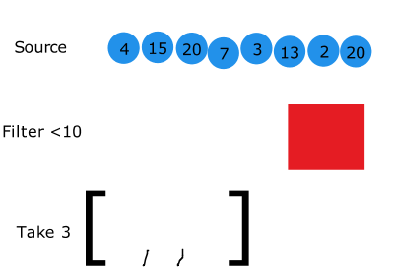
Array filter()
The array.filter() method creates a new array filtered by a provided function
function isBigEnough(element) {
return element < 10;
} // declaring callback function
var filtered =
[4, 15, 20, 7, 3].filter(isBigEnough);
// filtered array is [4, 7, 3]

Slide 29
Array map()
The array.map() method creates a new array with the results of calling a provided function on every element in this array.
var numbers = [1, 4, 9];
var doubles = numbers.map(function(num) {
return num * 2;
});
// doubles is now [2, 8, 18]. numbers is still [1, 4, 9]

Slide 30
Push / Pop / Unshift / Shift
Live Demo

Slide 31
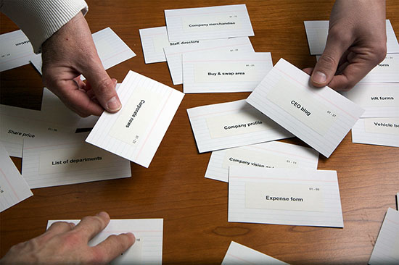
Sorting Arrays
Array.sort() and Array.sort(orderBy)

Slide 32
Sorting Arrays in JavaScript
array.sort()
Sorts the elements of the array (in ascending order)
Compares the elements by their string representation!
i.e. the number 23 is compares as the string "23"
Not quite sorted, right?
var numbers = [5, 4, 2, 3, 1, 4, 5, 6, 7];
numbers.sort();
console.log(numbers.join(', '));
// result: 1, 2, 3, 4, 4, 5, 5, 6, 7
var numbers = [5, 4, 23, 2];
numbers.sort();
console.log(numbers.join(', ')); // result: 2, 23, 4, 5

Slide 33
Sorting Arrays with Compare Function
array.sort(compareFunc)
Sorts element using a compare function
The compare function defines the sorting rules
Return negative or 0 to leave the elements
Return positive to swap them
var numbers = [5, 4, 23, 2];
numbers.sort(function(a, b) {
return a > b;
});
console.log(numbers.join(', '));
// returns 2, 4, 5, 23

Slide 34
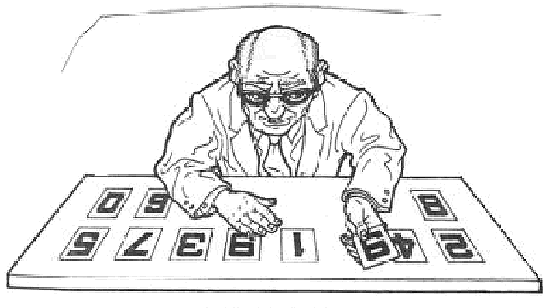
Sorting Arrays
Live Demo

Slide 35
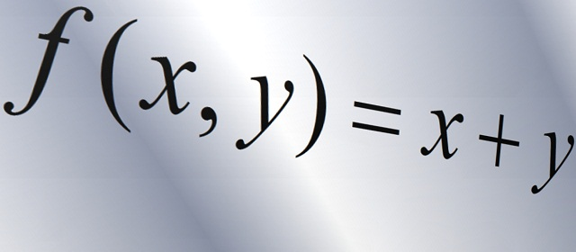
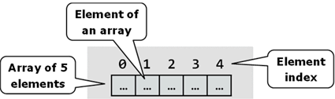
Other Array Functions

Slide 36
Other Array Functions
array.reverse()
Returns a new arrays with elements in reversed order
array.slice(start, end)
Extracts elements from an array (start…end-1)
array.concat(elements)
Appends elements at the end of the array
array.join(separator)
Concatenates the elements of the array

Slide 37
Other Array Functions (2)
array.filter(function(item){ return true / false })
Returns a new array with the elements that satisfy condition
array.forEach(function(item){ … })
Iterates through the array and executes the function for each item
array.indexOf(element)
Returns the index of the first match in the array
Returns -1 is the element is not found
array.lastIndexOf(element)
Returns the index of the first match in the array or -1 (not found)

Slide 38
Other Array Functions
Live Demo

Slide 39
Arrays – Additional Information
Arrays official documentation:
https://developer.mozilla.org/en-US/docs/Web/JavaScript/Reference/Global_Objects/Array
Checking for array
typeof([1, 2, 3]) → object
Array.isArray([1, 2, 3]) → true

Slide 40

Strings
Working with Strings in JavaScript

Slide 41
Strings in JavaScript
A string is a sequence of characters
Text enclosed in single (' ') or double quotes (" ")
var str1 = "Some text in a string variable";
var str2 = 'Text enclosed in single quotes';
String is a primitive type
It is copied / passed by value
String is also immutable
Every time a string is changed, a new string is created

Slide 42
String Methods
string.length
Returns the number of characters in the string
Indexer (string[index])
Gets a single-character string at location index
If index is out of range, returns undefined
string[-1] or string[string.length] → undefined
charAt(index)
Gets a single-character string at location index (just like [])

Slide 43
String Methods (2)
string.concat(anotherString)
Returns a new string – the concatenation of the two strings
string.replace(str1, str2)
Replaces first occurrence of str1 with str2
string.search(regex)
Searches for a substring based on regular expression
var s = 'My mail is email@host.com, please contact me';
var emailIndex = s.search(/\S+@\S+/); // 11

Slide 44
String Methods (3)
string.indexOf(substring [, position])
Returns the left-most occurrence of substring (after the position)
Position is optional and has default value of 0
If string doesn't contain substring, returns -1
string.lastIndexOf(substring [, position])
Returns the right-most occurrence of substring (before position)
Position is optional, default value is string.length
If string doesn't contain substring, returns -1

Slide 45
String Methods (4)
string.substr(start[, length])
Returns a substring by start and length (length is optional)
string.substring(start, end)
Returns a substring, starting from start and ending at end
string.valueOf()
Returns the primitive value of the object string
str.trim(), str.trimLeft(), str.trimRight()
Removes the whitespace from the start / end of the string

Slide 46
String Methods (5)
string.split(separator)
Splits the string by separator and returns an array of strings
Separator can be a regular expression, e.g. s.split(/[\s,]+/)
var tokens = 'C#, Java, PHP ,HTML'.split(',');
// tokens = ['C#', ' Java', ' PHP ', 'HTML']
var tokens = 'C#, Java, PHP;\n JS'.split(/[\s,;]+/);
// tokens = ['C#', 'Java', 'PHP', 'JS']

Slide 47
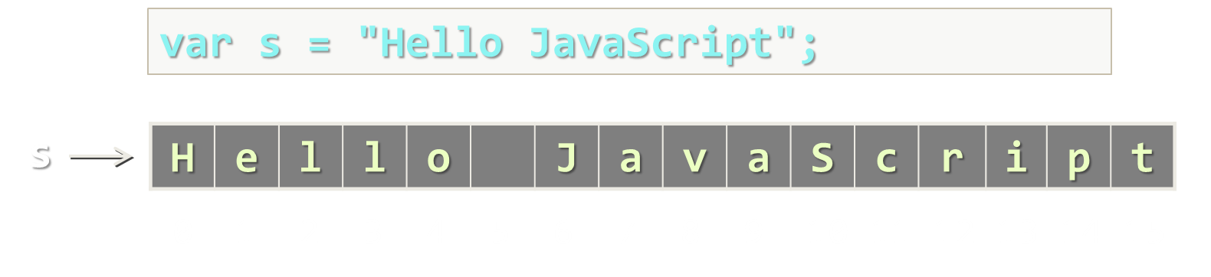
String Methods
Live Demo

Slide 48
String Wrapper
As string is a primitive type, it has a object wrapper type
Primitive types keep only their value
When a property / method is called, the JS engine converts the primitive into its corresponding object type and calls the property
var str = 'sample';
var tempStr = new String(str);
tempStr.length;
var str = 'sample';
str.length;
same as
String.prototype.len2 = function() { return this.length * 2; }
var lenTwice = 'hello'.len2(); // 10

Slide 49
From Object to Primitive Type
JavaScript have a simple parsing from string to number:
Conversion from primitive to object type:
new String('…') creates a string object
String(strObject) creates a primitive string
var str = '42';
var num = Number(str); // 42
var base = 'string'; // "string"
var strObj = new String(base);
// String {0: "s", 1: "t", 2: "r", 3: "i", 4: "n", 5: "g"}
var str = String(strObj); // "string"

Slide 50
String Concatenation
Live Demo

Slide 51

HTML Escaping

Slide 52
String Escaping
What is escaping?
Replacing reserved characters with their escape sequence
Prevents JavaScript injection
When using JavaScript client-side reserved characters are '<', '>', '&', "'" and '"'
document.body.append(
'<script>' +
"document.location = 'http://bad_place.com'" +
'</script>');

Slide 53
String Escaping (2)
Escaping is done by just replacing the reserved characters with their escape sequence
Can be attached to the string prototype
String.prototype.htmlEscape = function() {
var escapedStr = String(this).replace(/&/g, '&amp;');
escapedStr = escapedStr.replace(/</g, '&lt;');
escapedStr = escapedStr.replace(/>/g, '&gt;');
escapedStr = escapedStr.replace(/"/g, '&quot;');
escapedStr = escapedStr.replace(/'/g, '&#39');
return escapedStr;
}

Slide 54
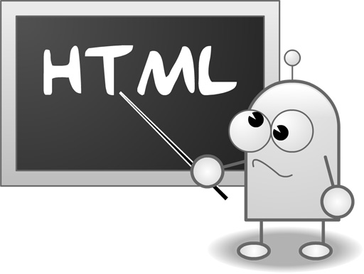
HTML Escaping
Live Demo

Slide 55


Summary
Loops in JavaScript (Same as in C#, Java, C++ )
Functional forEach()
Arrays in JavaScript
We can have array of elements from different types
Dynamic Arrays, Sorting
Strings in JavaScript
String Concatenation, String Wrapper, HTML Escaping
JS Basics

Slide 56








JavaScript – Loops, Arrays and Strings
https://softuni.bg/courses/javascript-basics

Slide 57
License
This course (slides, examples, demos, videos, homework, etc.) is licensed under the "Creative Commons Attribution-NonCommercial-ShareAlike 4.0 International" license
Attribution: this work may contain portions from
“JavaScript Basics" course by Telerik Academy under CC-BY-NC-SA license

Slide 58






Free Trainings @ Software University
Software University Foundation – softuni.org
Software University – High-Quality Education, Profession and Job for Software Developers
softuni.bg
Software University @ Facebook
facebook.com/SoftwareUniversity
Software University @ YouTube
youtube.com/SoftwareUniversity
Software University Forums – forum.softuni.bg

